Slide 1

Modern Convolution Neural Networks
Dr. Risman Adnan
Telkom University

Slide 2
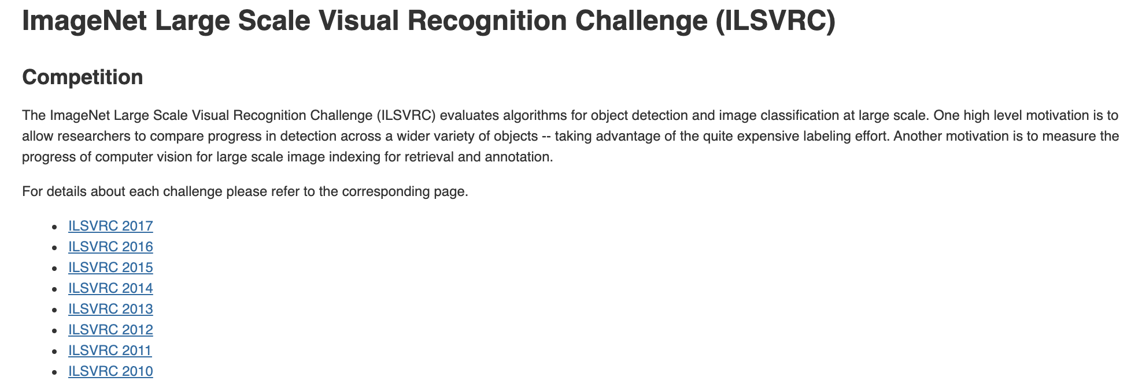
ILSVRC Competition

Slide 3
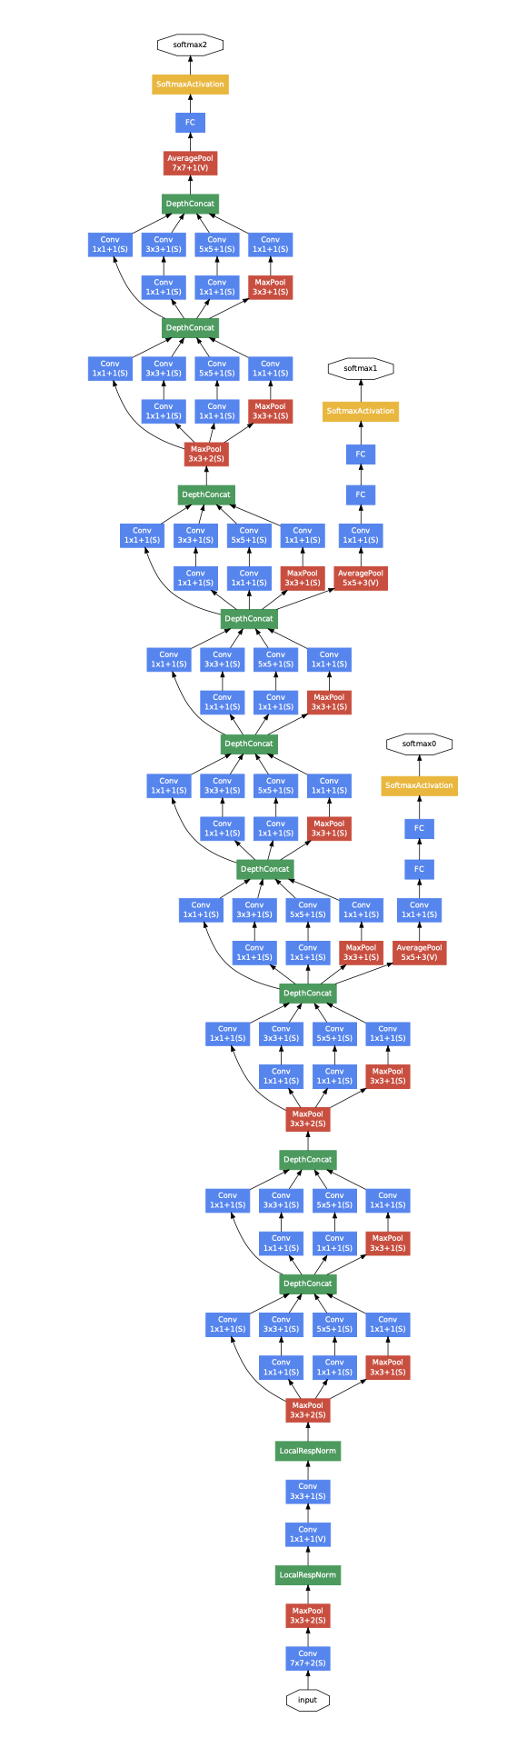
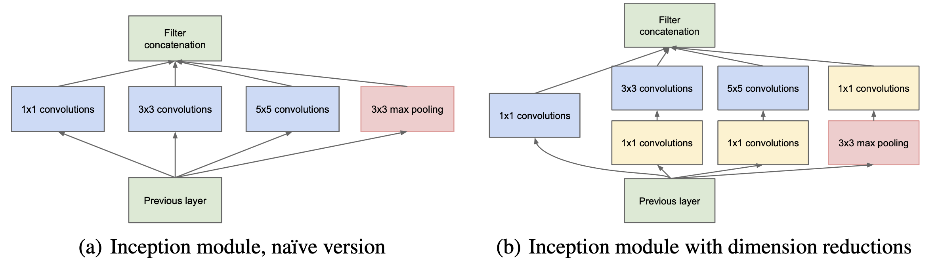
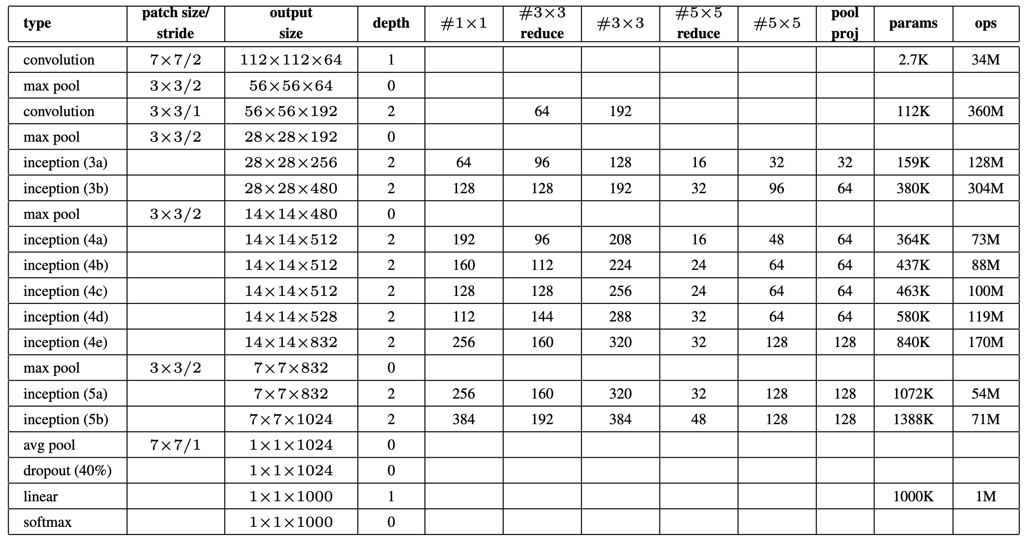
GoogLeNet Architecture
The main ideas: (1) Finding out how an optimal local sparse structure in CNN can be approximated and covered by readily available dense components (2) Dimensionality reduction and projection to reduce computation
Background:
Deeper network tend to overfit easily and require expensive computations
Hebbian principle – neurons that fire together wire together.
Statistics of the activations and cluster of neurons
Benefits:
Increase the number of units at each stage significantly without an uncontrolled blow-up in computational complexity.
Align with the intuition that visual information should be processed at various scales and then aggregated so that the next stage can abstract features from different scales simultaneously.
Notes:
Their main result states that if the probability distribution of the data-set is representable by a large, very sparse deep neural network, then the optimal network topology can be constructed layer by layer by analyzing the correlation statistics of the activations of the last layer and clustering neurons with highly correlated outputs. Although the strict math- ematical proof requires very strong conditions, the fact that this statement resonates with the well known Hebbian principle – neurons that fire together, wire together – suggests that the underlying idea is applicable even under less strict conditions, in practice.

Slide 4
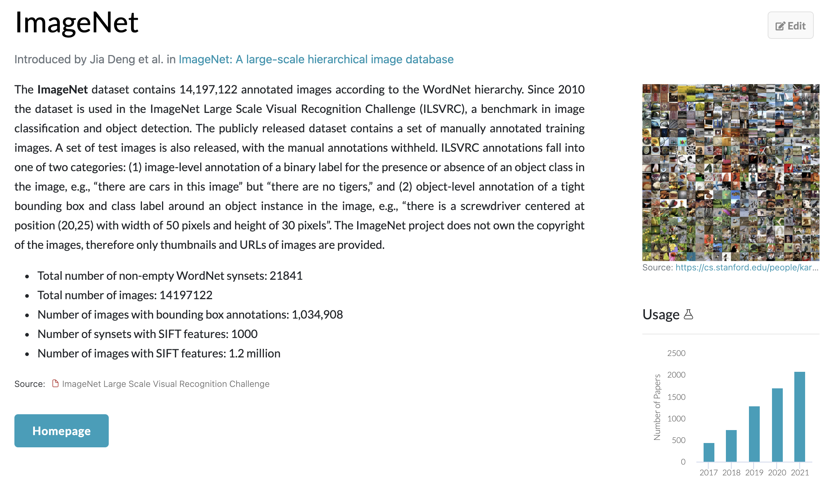
ILSVRC Dataset

Slide 5
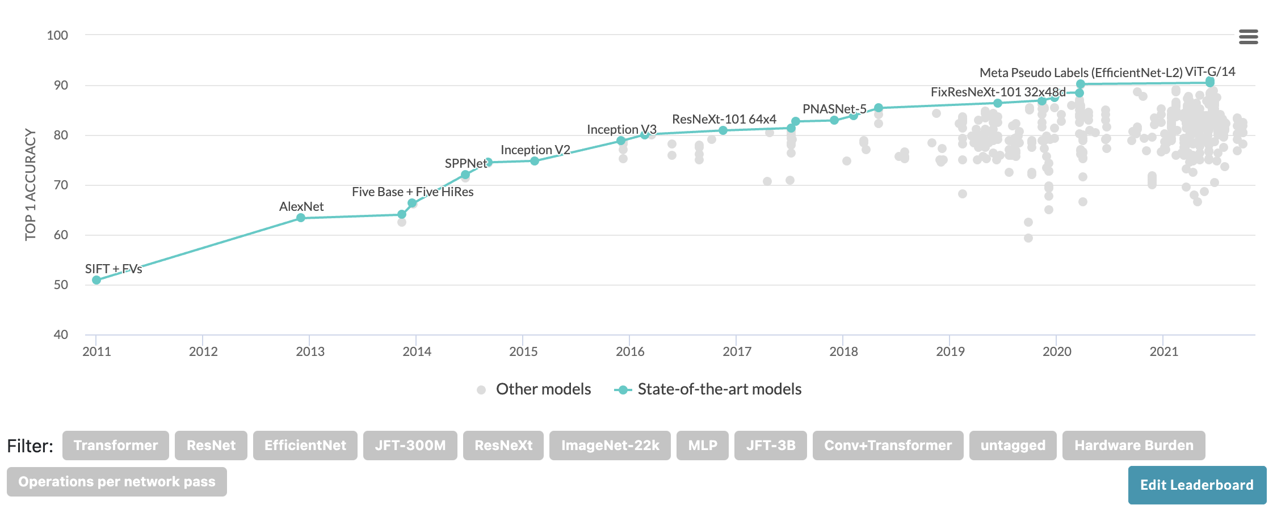
ILSVRC State of the Arts

Slide 6
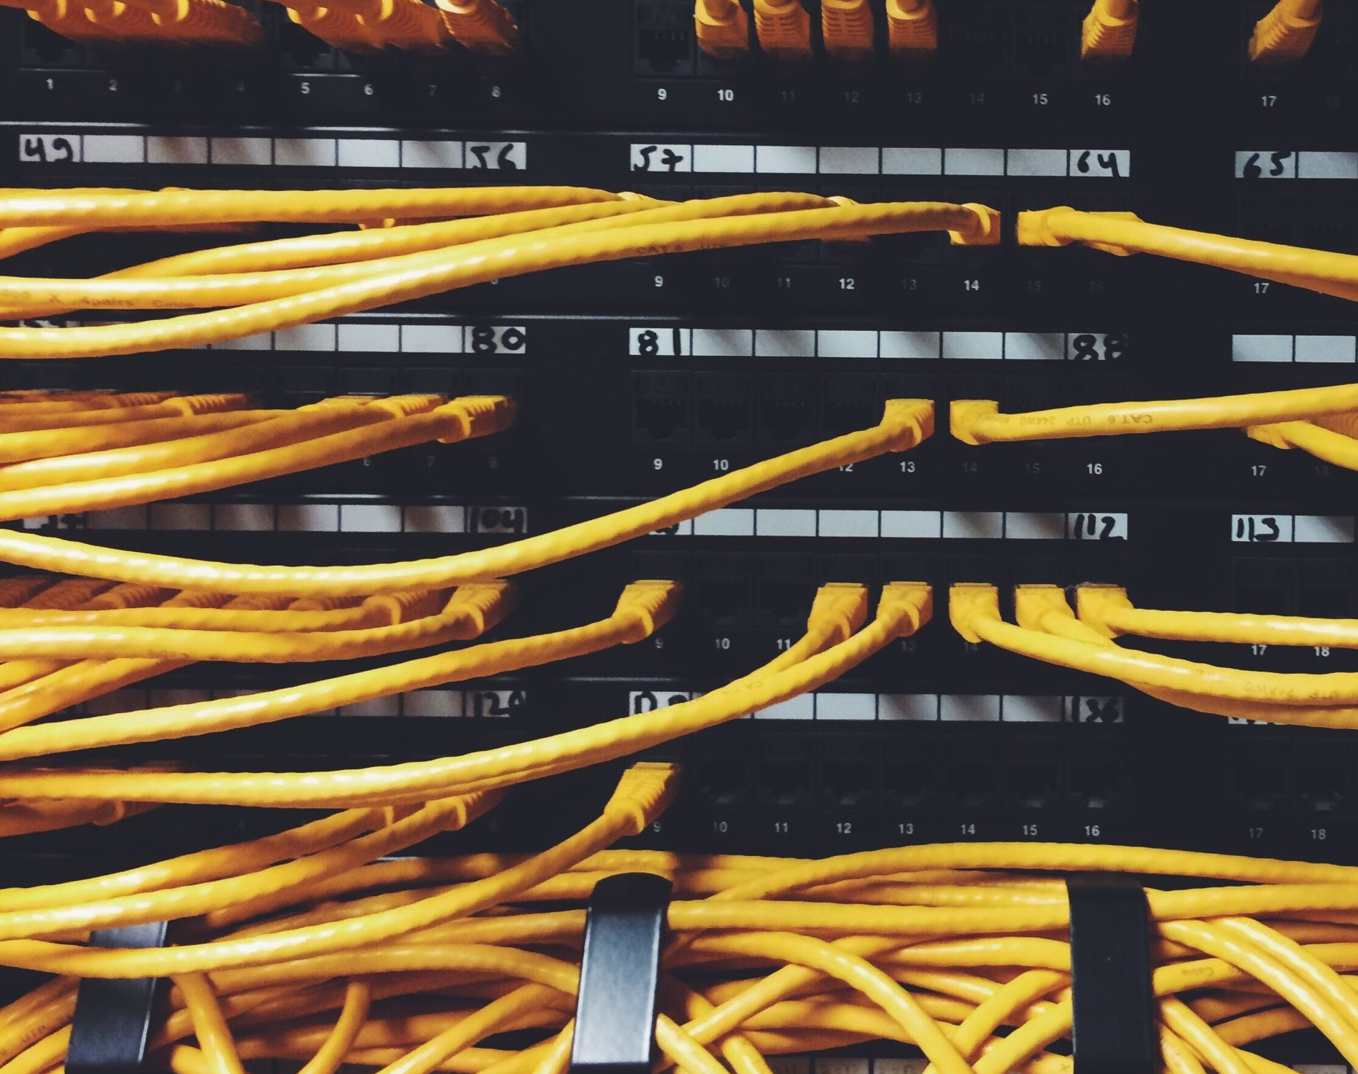
Outline
AlexNet
VGG
NiN
GoogLeNet
BatchNormalization
ResNet
DenseNet

Slide 7
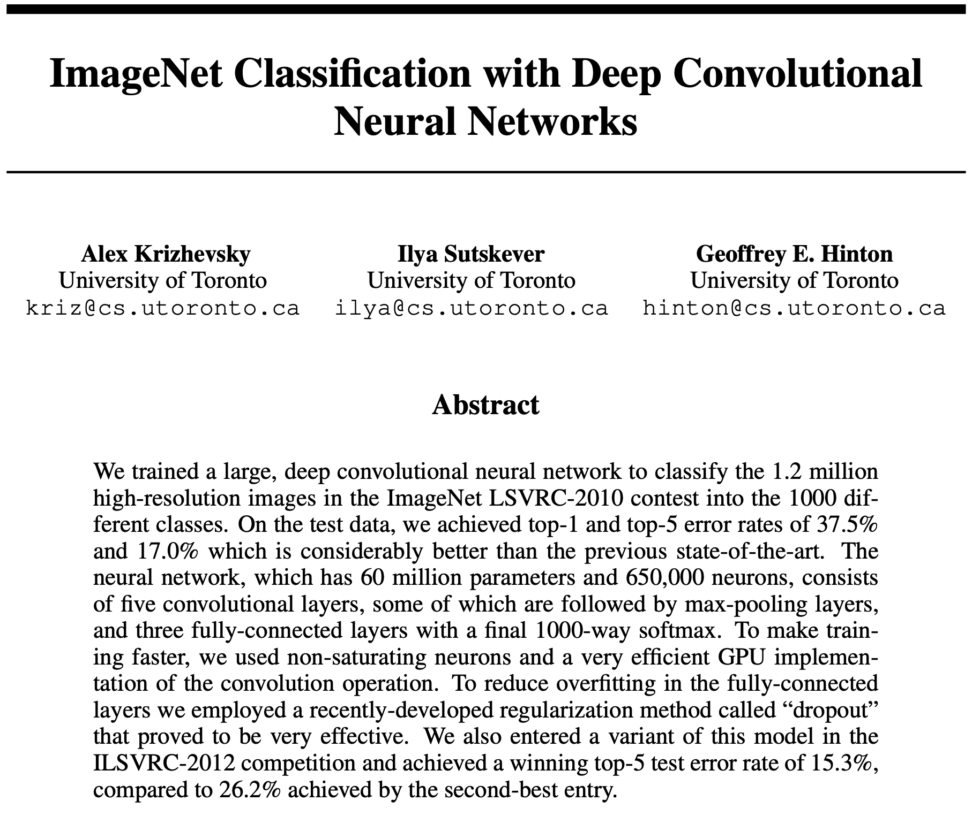
AlexNet
Problems
ImageNet Classification
How to Get Higher Accuracy
Contributions
AlexNet Architecture
ReLu Activation
Training Multiple GPUs
Local Response Normalization
Overlapping Pooling
ILSVRC 2010 and 2012 Winner
Handle Overfitting Well
Data Augmentation
Dropout Technique

Slide 8
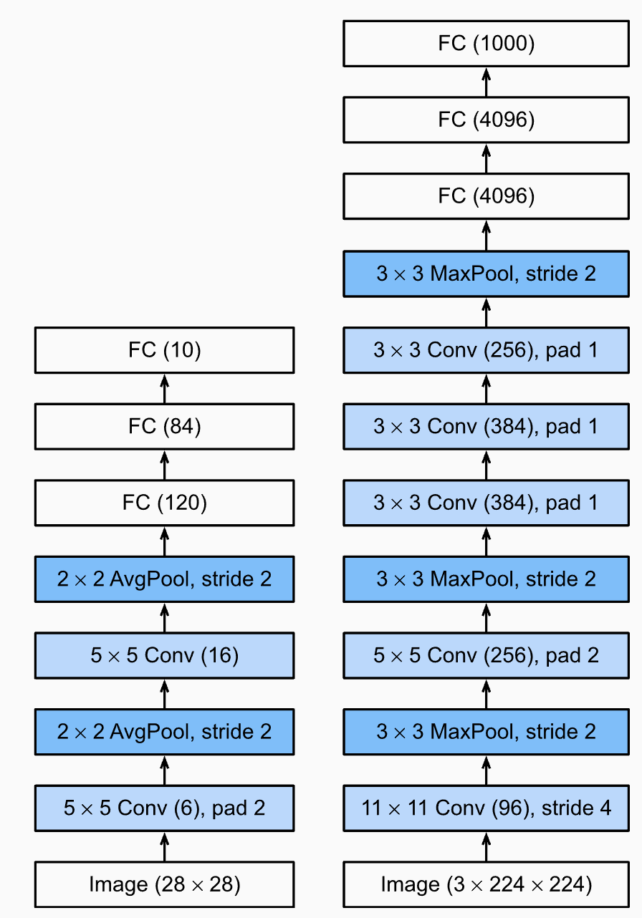
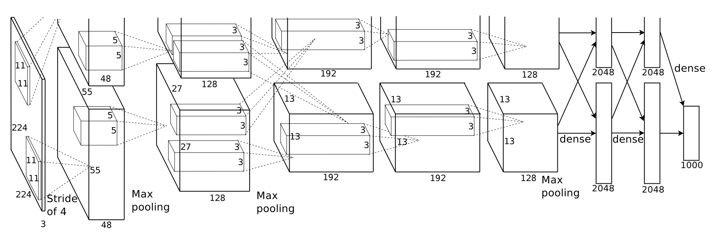
AlexNet Architecture
The network’s input is 150,528-dimensional, and the number of neurons in the network’s remaining layers is given by 253,440–186,624–64,896–64,896–43,264– 4096–4096–1000.

Slide 9
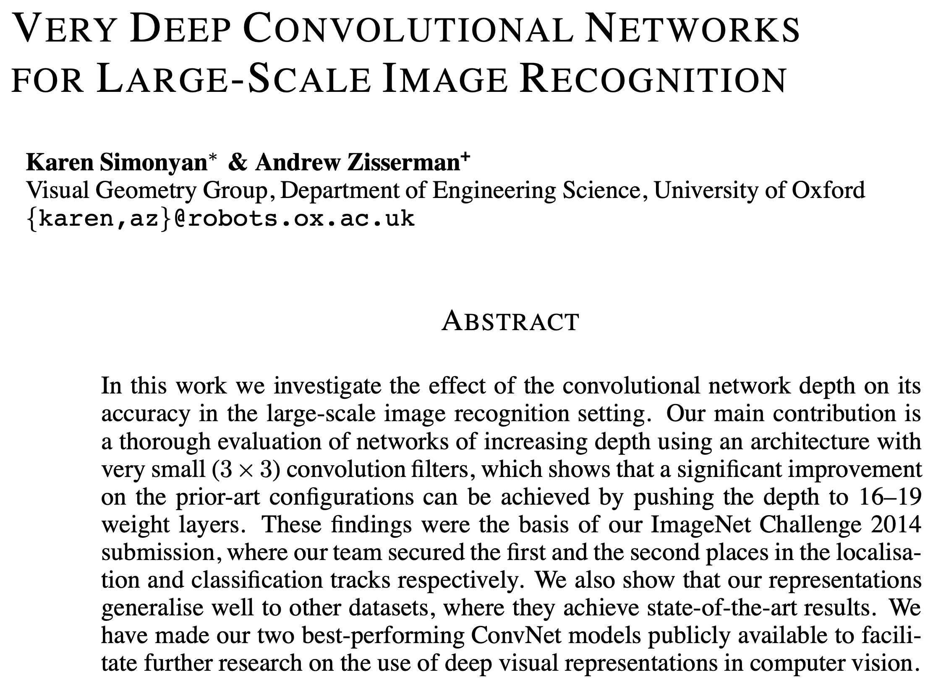
VGGNet
Problems
ImageNet Classification
Higher Accuracy By Increasing Depth
Contributions
VGGNet Architecture
19 Weight Layers
Small convolutional filters
ReLu Activation
Only one LRN Layer
ILSVRC 2014 2nd Winner
Handle Overfitting Well
Dropout Technique

Slide 10
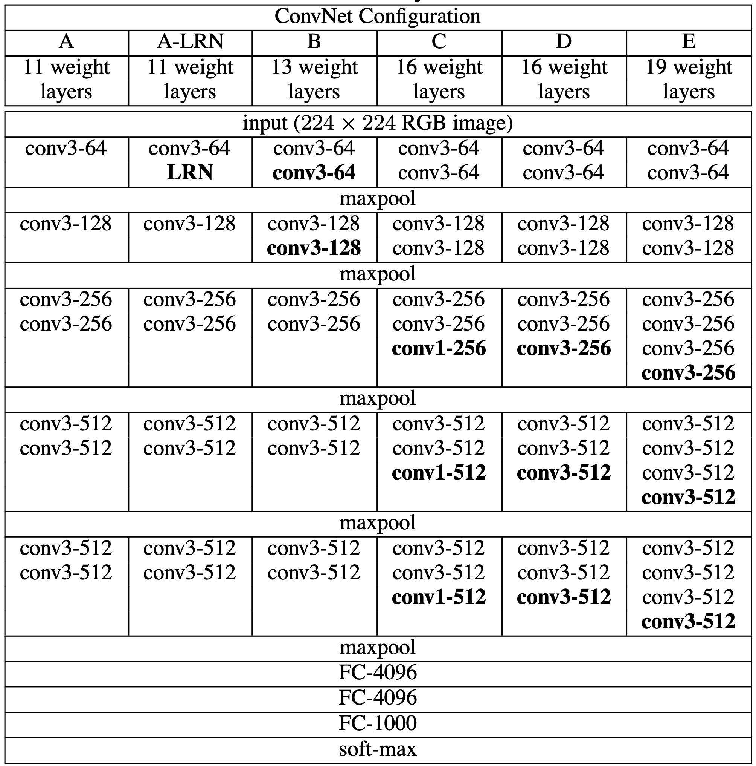
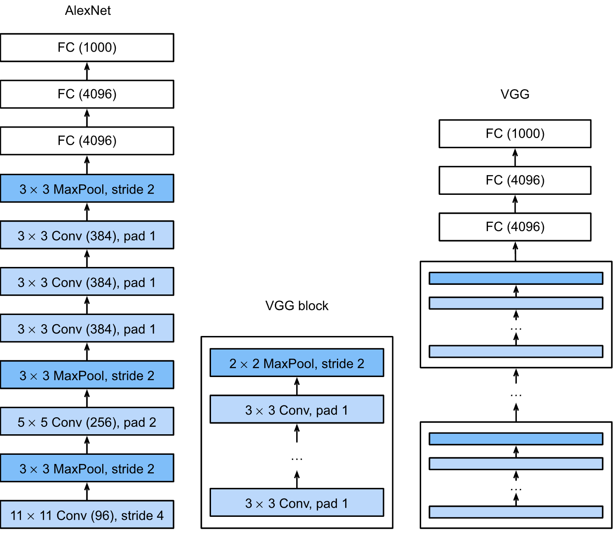
VGGNet Architecture
The depth of the configurations increases from the left (A) to the right (E), as more layers are added (the added layers are shown in bold). The convolutional layer parameters are denoted as “conv⟨receptive field size⟩-⟨number of channels⟩”. The ReLU activation function is not shown for brevity.

Slide 11
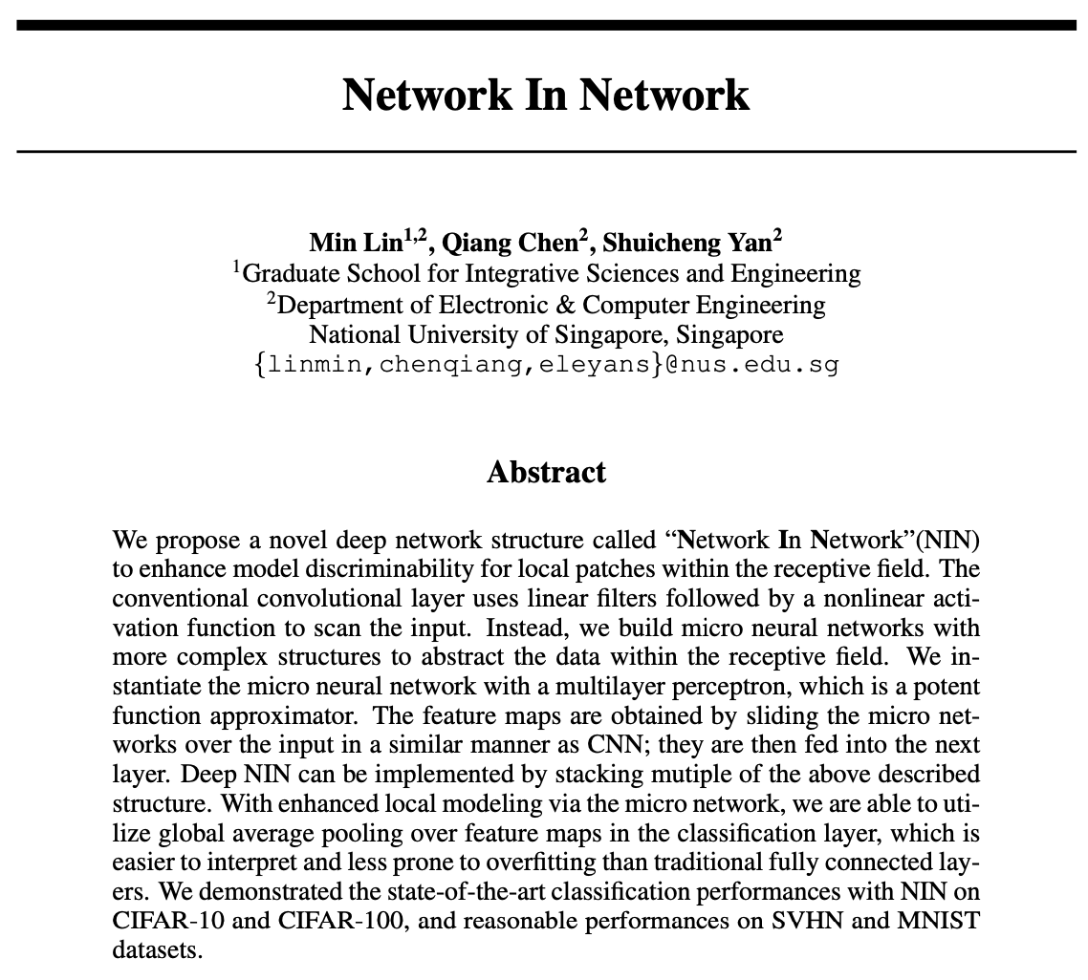
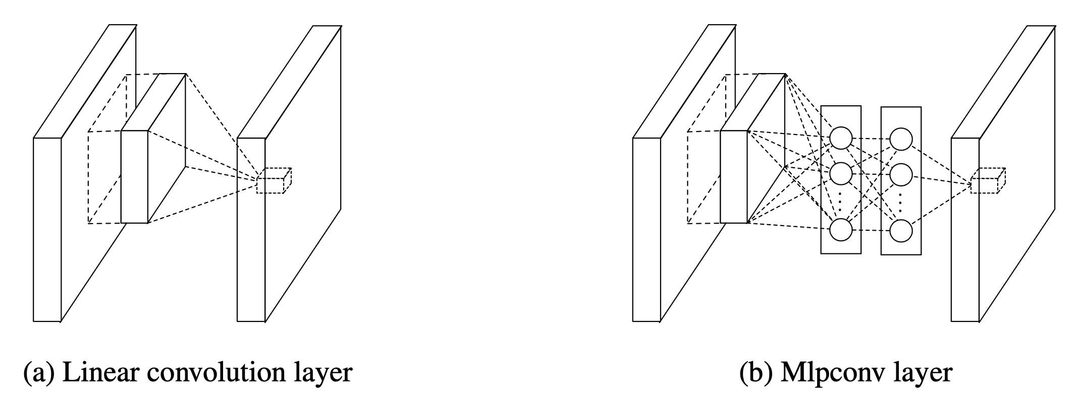
NiN
Problems
ImageNet Classification
Enhance discriminability
Contributions
NiN Architecture
Micro Neural Nets with MLP
Replace CNN with MlpConv
MlpConv is MLP with Nonlinearity (ReLu)
SoftMax Layer for Classification
Handle Overfitting Well
Global Average Pooling

Slide 12
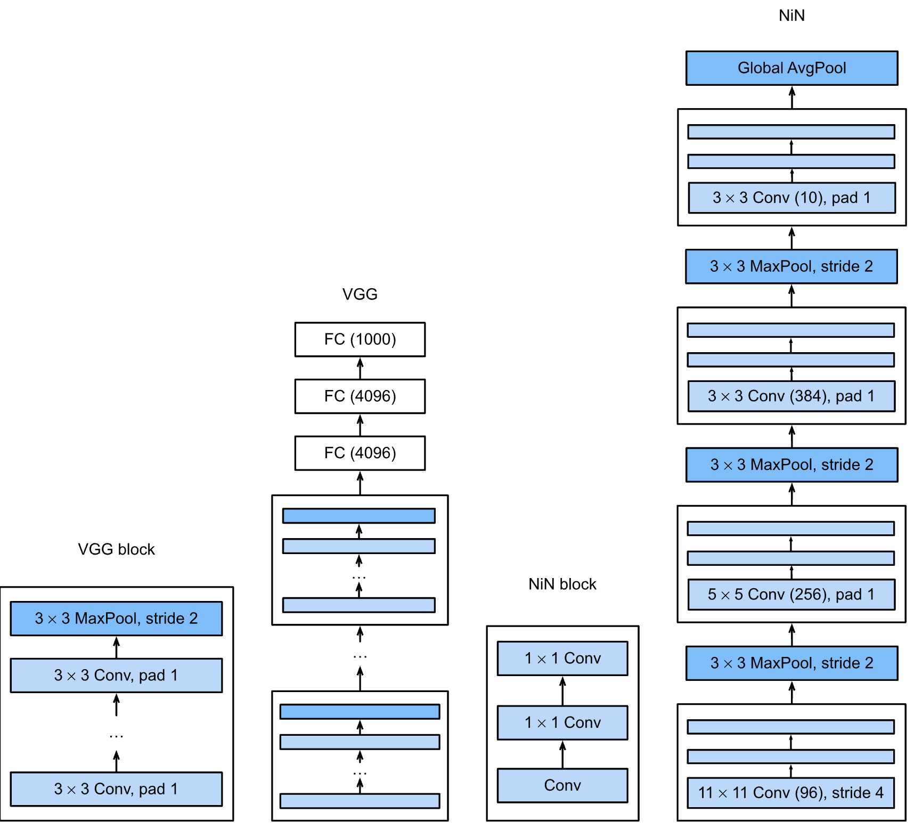
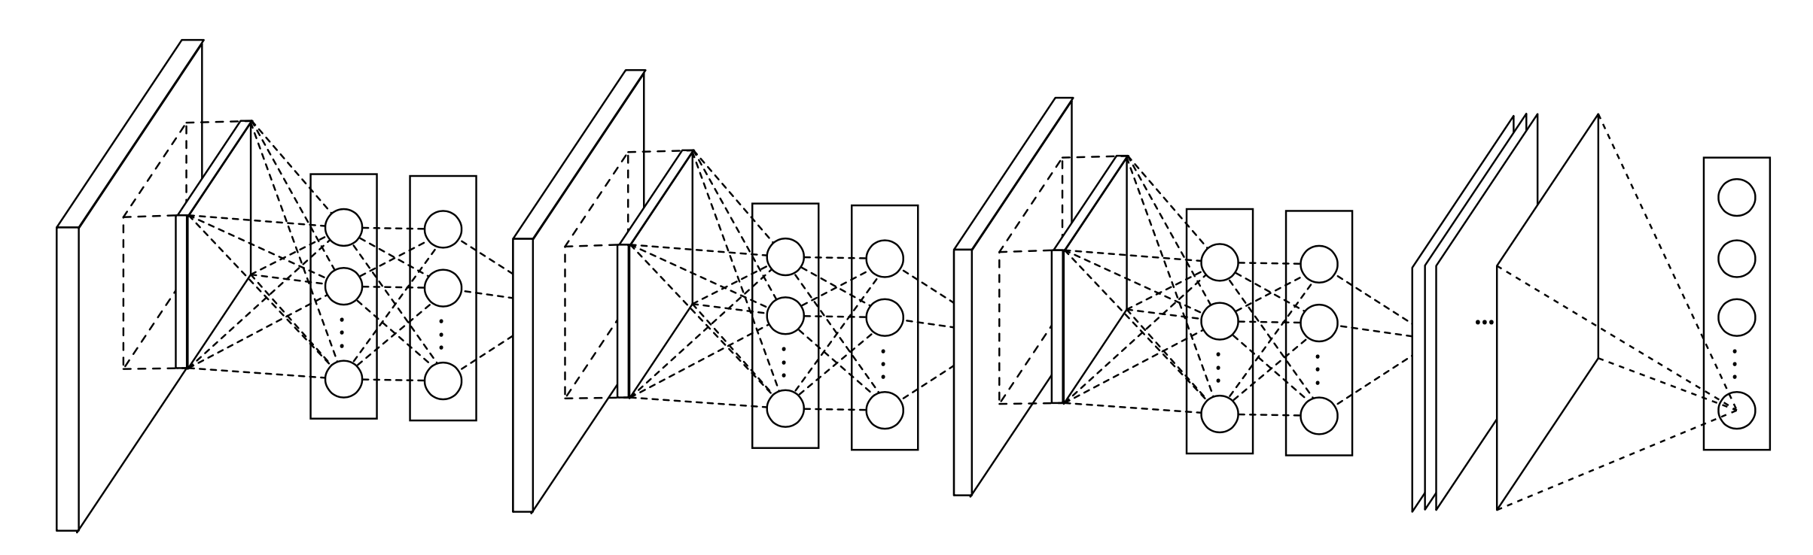
NiN Architecture
The overall structure of Network In Network. In this paper the NINs include the stacking of three MLPConv layers and one global average pooling layer. MLPConv layers model the local patches better, and global average pooling acts as a structural regularizer that prevents overfitting globally.

Slide 13
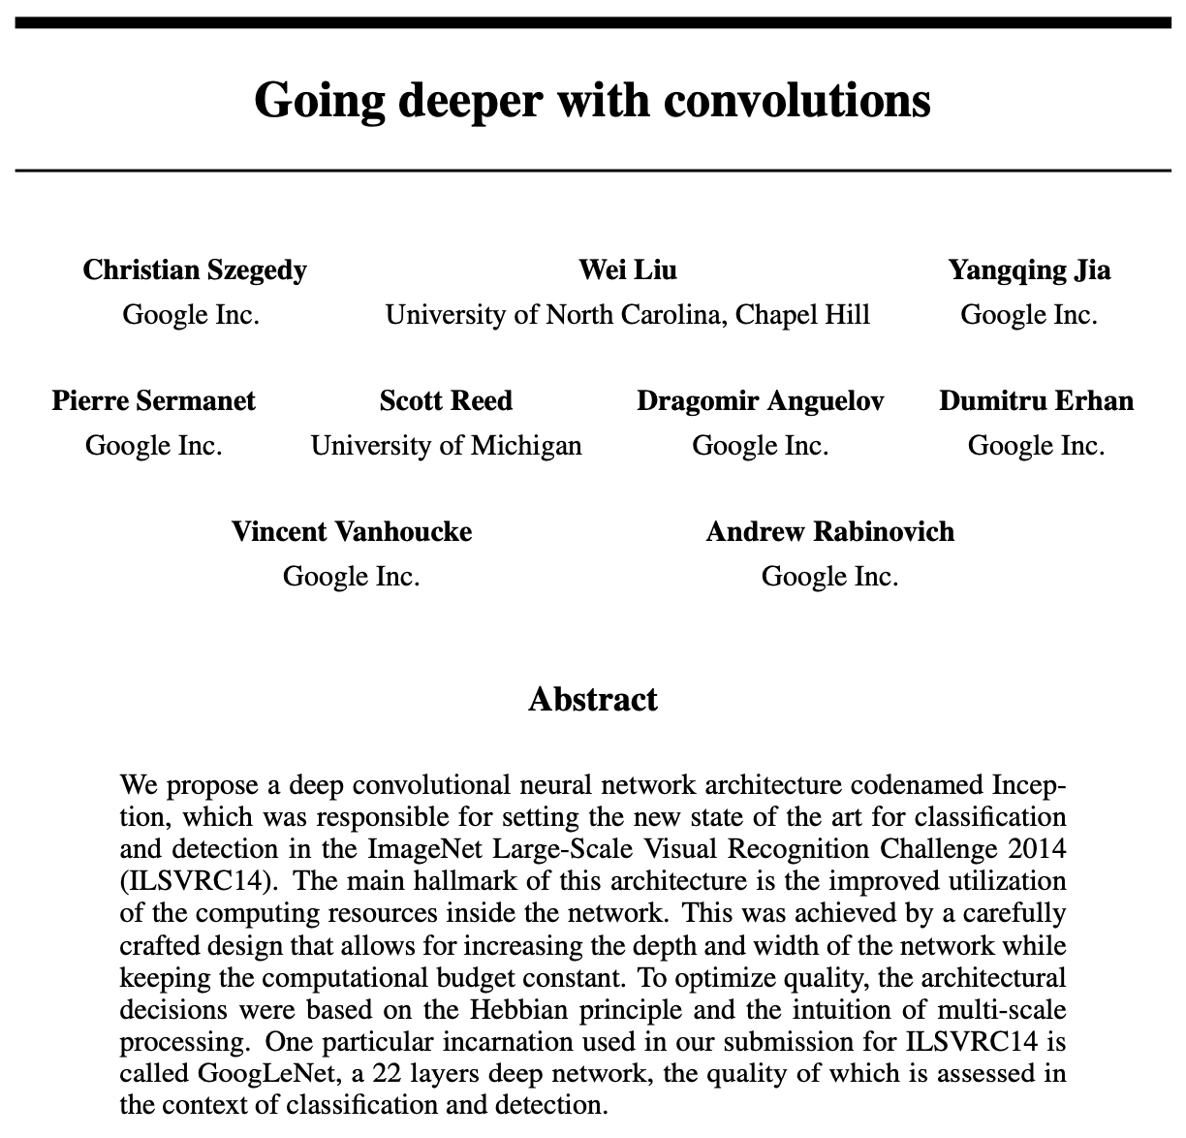
GoogLeNet
Problems
ImageNet Classification
Efficient computing resources
Contributions
GoogLeNet Architecture
Synergy between deep networks and computer vision
Introduce Inception module
Increase depth and width with constant budget
Hebbian principle
Multiscale processing
22 layers deep network
ILSVRC 2014 Winner
Handle Overfitting Well
Data Augmentation
Dropout Technique

Slide 14
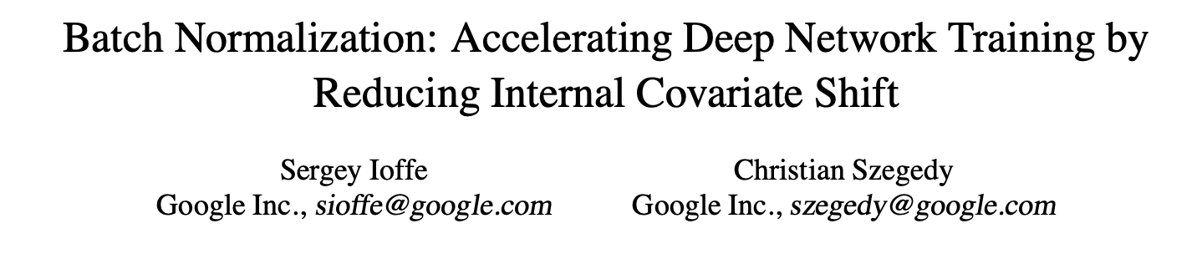
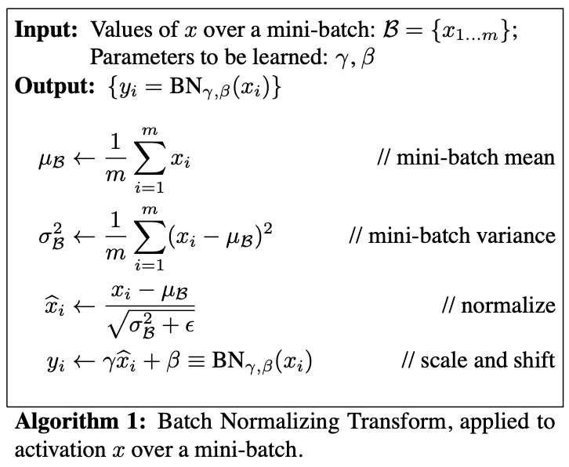
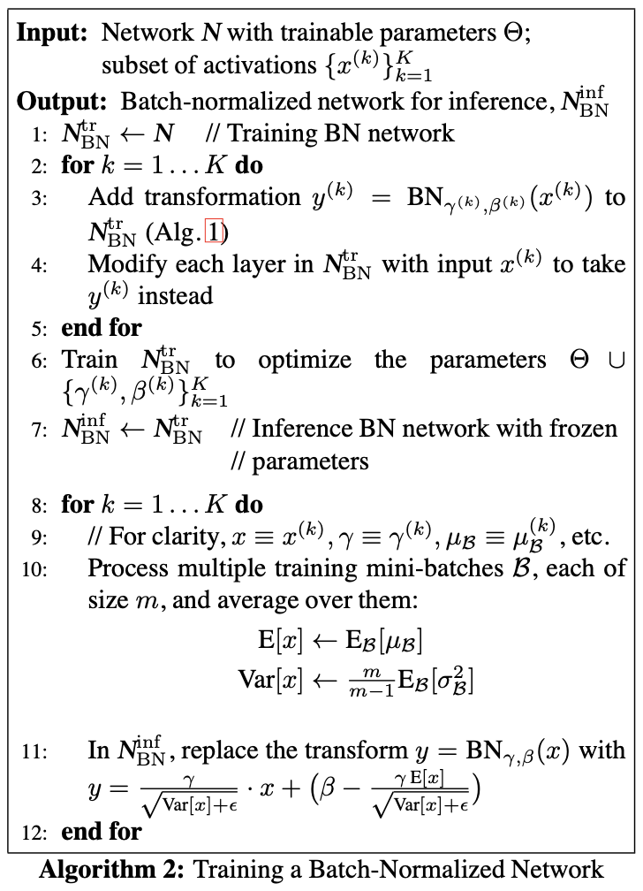
Batch Normalization
Problems:
Hot to accelerate convergence of DNN training
How to handle Internal Covariate Shift
Approach:
Normalizing layer inputs
Normalization a part of the model architecture
Normalization for each training mini-batch
Benefits:
BN allows us to use much higher learning rates
BN provide better parameter scale and initialization
Acts as a regularizer, reduces need of Dropout
BN makes it possible to use saturating nonlinearities

Slide 15
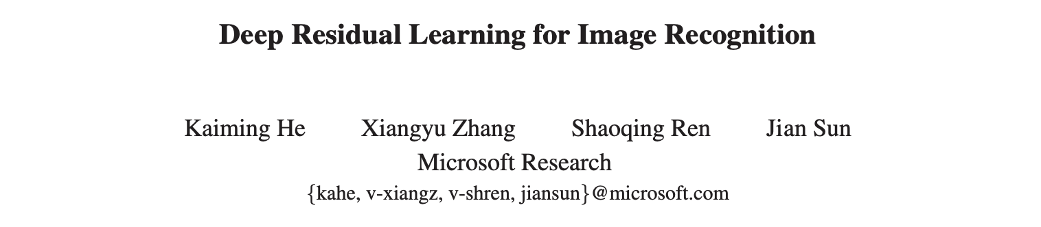
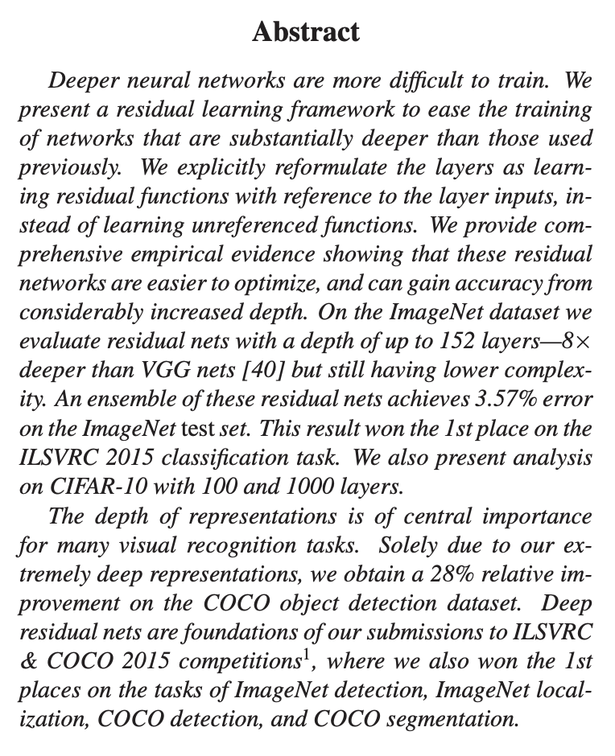
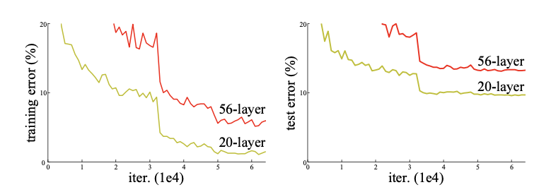
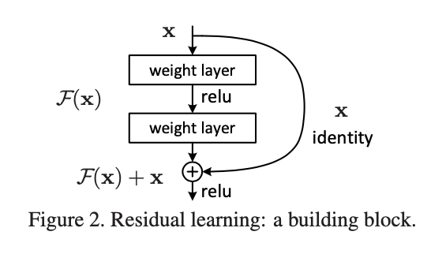
ResNet
Problems
Is learning better networks as easy as stacking more layers?
The degradation problem with deeper networks
How to train and improve accuracy of deeper networks
Contributions
Reformulate the layers as learning residual functions
Deep residual learning framework
Hypothesize that it is easier to optimize the residual mapping than the original, unreferenced mapping. If an identity mapping were optimal, it would be easier to push the residual to zero than to fit an identity mapping by a stack of nonlinear layers.
1st Winner of ILSVRC 2015 classification competition

Slide 16
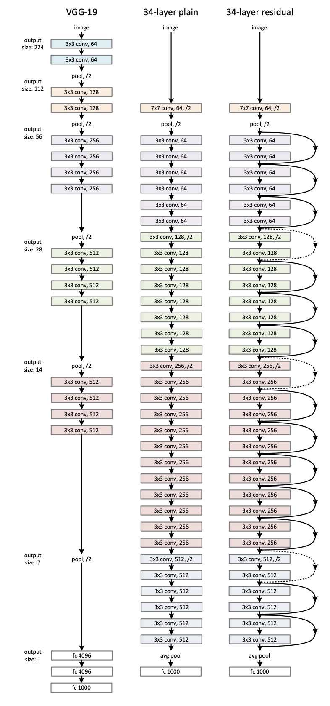
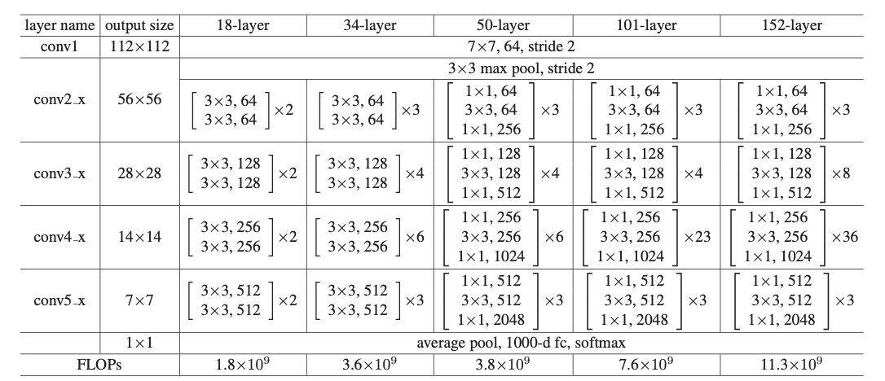
ResNet Architecture

Slide 17
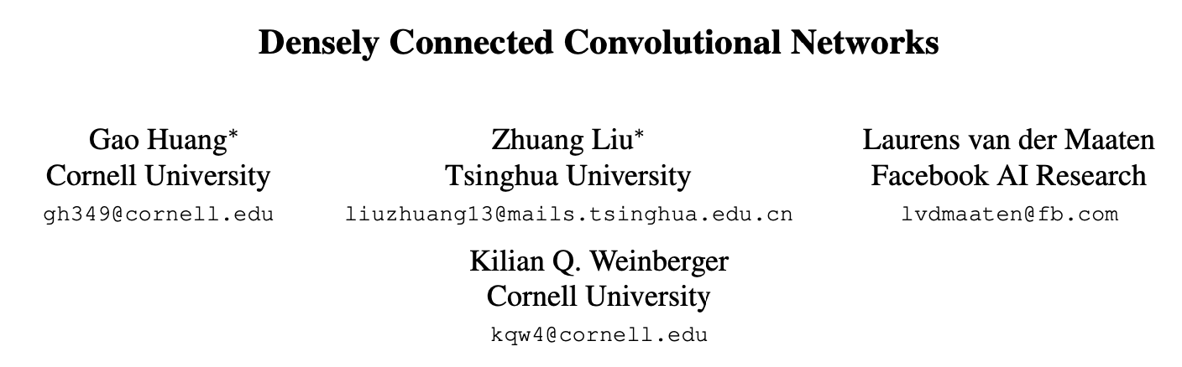
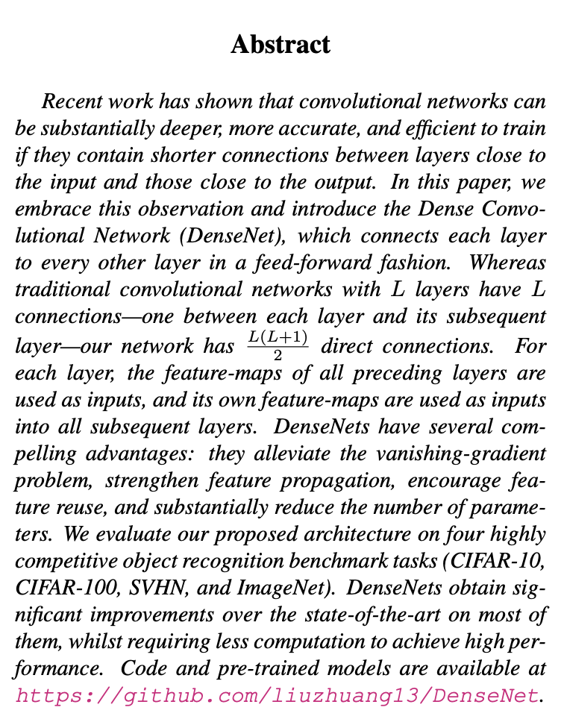
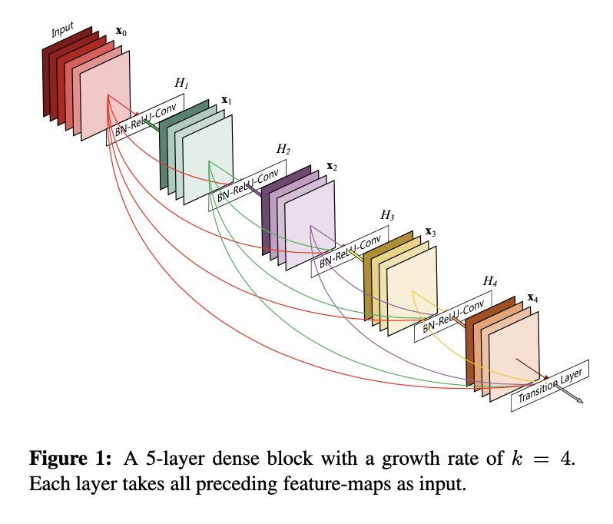
DenseNet
Problems
Is learning better networks as easy as stacking more layers?
The degradation problem with deeper networks
How to train and improve accuracy of deeper networks
Approach:
Ensures maximum information flow between layers in the network
Connects all layers (with matching feature-map sizes) directly with each other
Connects each layer to every other layer in a feed-forward nature
Each layer obtains additional inputs from all preceding layers and passes on its own feature-maps to all subsequent layers.

Slide 18
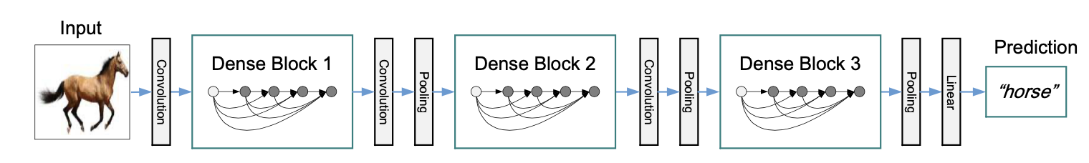
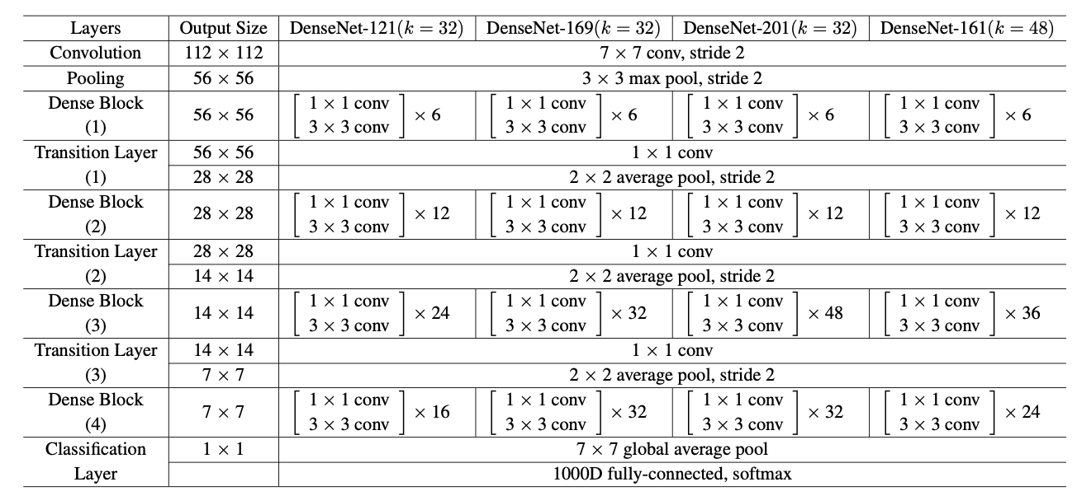
DenseNet Architecture
Benefits:
Fewer parameters than traditional CNNs, as there is no need to relearn redundant feature-maps.
Improved flow of information and gradients throughout the network, easier to train.
Each layer has direct access to the gradients from the loss function and the original input signal, leading to an implicit deep supervision.
Dense connections have a regularizing effect, which reduces overfitting on tasks with smaller training set sizes.

Slide 19
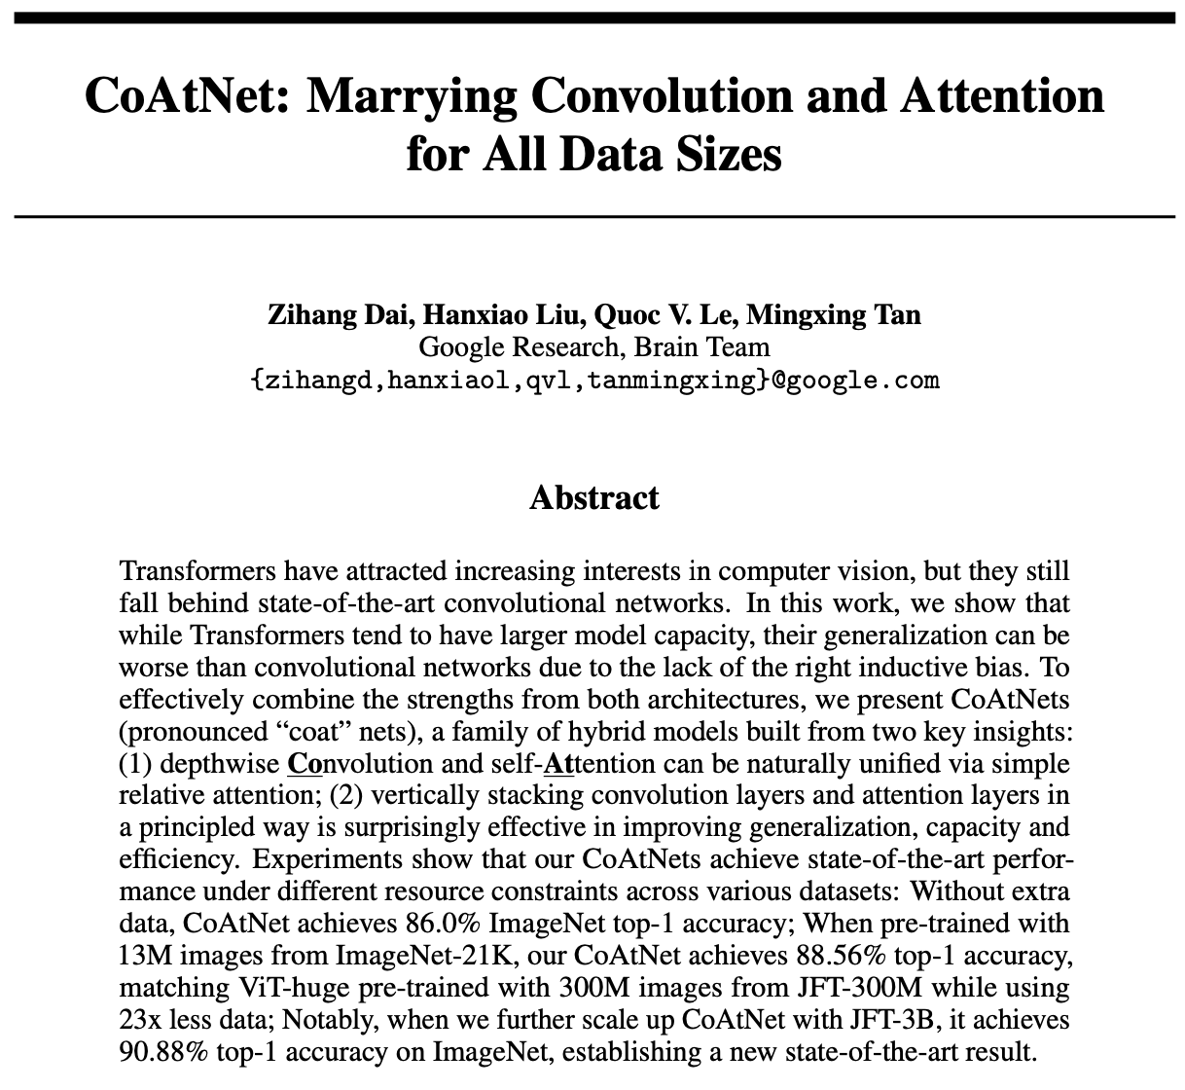
CoAtNet

Slide 20
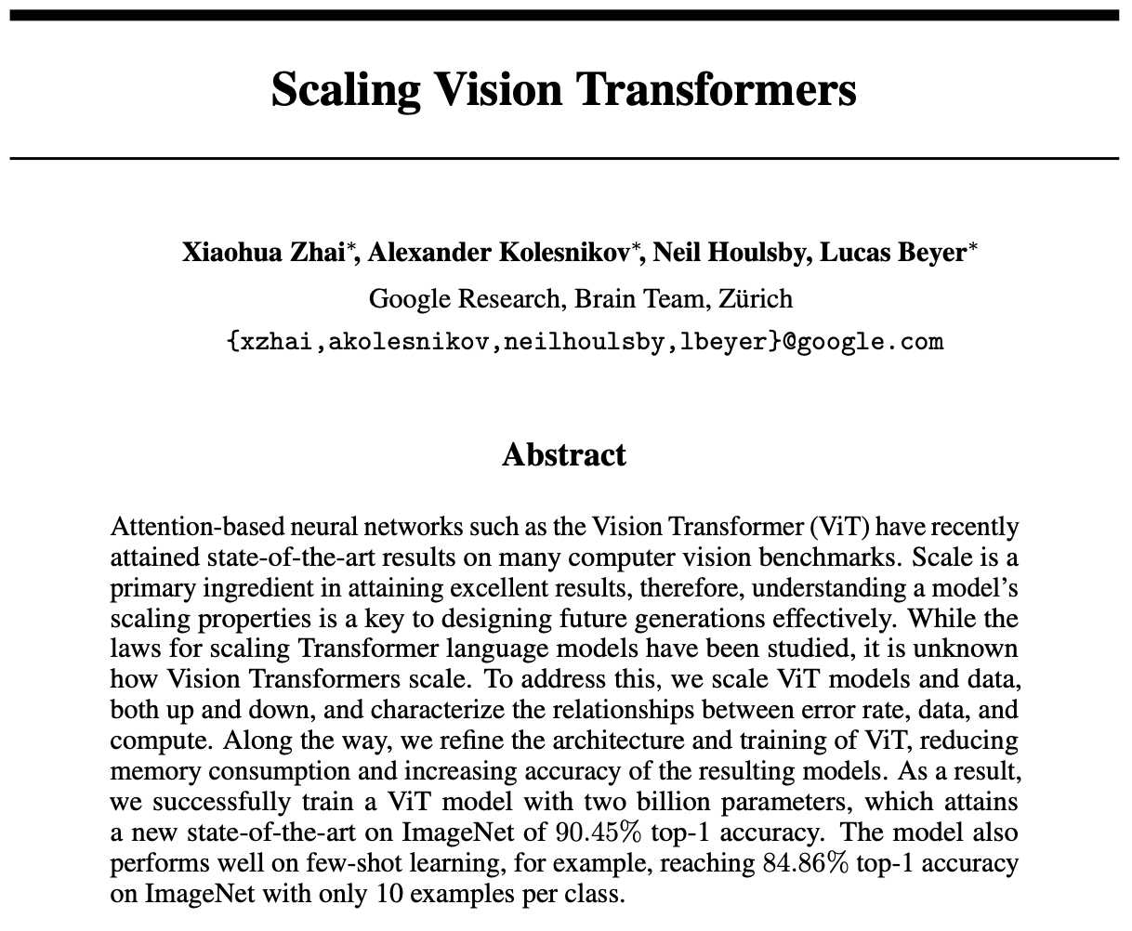
ViT

Slide 21
D2L.ai Homeworks
AlexNet
VGG
NiN
GoogLeNet
BatchNormalization
ResNet
DenseNet

